Slide 1

OSINT
(OPEN SOURCE INTELLIGENCE)

Slide 2


INTRODUCTION TO OSINT

Slide 3
What is OSINT
OSINT is the collection, analysis and dissemination of information that is legally and publicly accessible via open sources.
Open sources such as the internet and discarded items (papers containing info)
Used by hackers, pentesters, journalists, and federal law enforcement
Two ways of conduction OSINT
Passive and Active
Passive is monitoring and using the internet to gather info
Active OSINT requires physical or riskier actions to get certain info
*OSINT should ALWAYS be the first step to any successful hack or pentest!

Slide 4
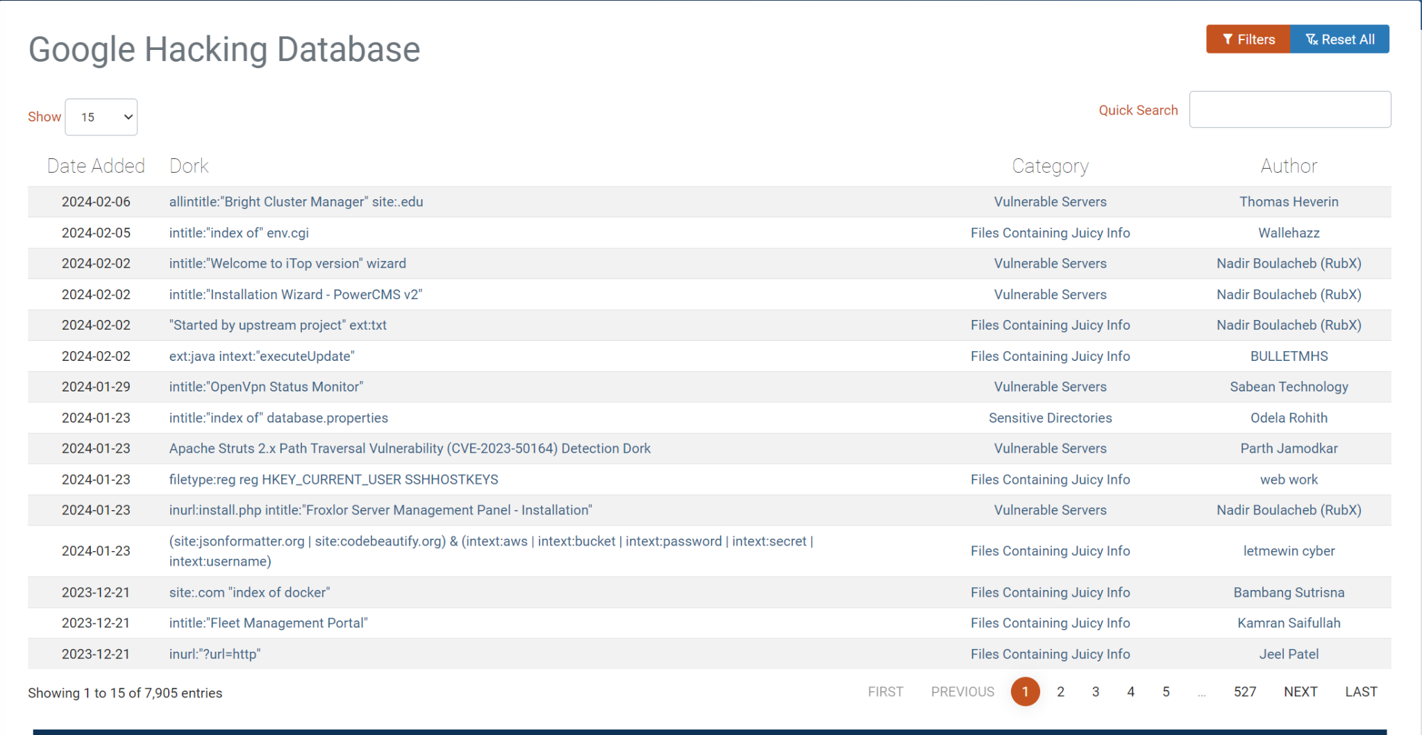
How to use OSINT
OSINT can be used via the internet or physical efforts
On a KALI Linux machine or via your own device (PC/PHONE) open Google
Navigate to the “Google Hacking Database” (GHDB)
Once there click on any link that is listed (see below)
You can use the links provided to “Dork”

Slide 5
Tools for OSINT
Using various OSINT tools gives you the upper hand for recon
Reverse image searches, facial recognition software, and Google Dorks
Google Dorking is narrowing down searches to find info that is hidden yet accessible
For example typing “gaming computers” on google will give millions of sites
But typing in “site:amazon.com gaming computers” will show only Amazon results
Cool huh???
To look up somebody, tools like thatsthem.com or typing in their name in Google can give results to their address, name, height, weight etc…

Slide 6
Tools for OSINT PT.II
If a target’s EMAIL was found through Google Dorking, tools like haveibeenpwned or epios.com can look for anything related to the email
Social Media gives lots of info, look up on IG or FACEBOOK or TWITTER #newjob or anything related to that phrase
There are also tools like OSINTGRAM or TWINT which can scrape a persons IG or TWITTER account(s) (TWINT uses geolocation!! & Bypasses Twitter API!)
Social-searcher.com or checkusernames.com looks for social media accounts of a target when there full name is given or username given
For scanning faces tools like facecheck.id uses AI to look for a targets face on the internet

Slide 7
Additional Tools
Tineye-Reverse Image Search
Shodan-IOT device search engine
Yandex.ru-Russian search engine similar to Google
PicTriev-Age guesser
WayBack-Machine Archives
Haveibeenpwned-email data breach/leak analyzer
Maltego-Automated OSINT framework (KALI LINUX TOOL)
Github Clones-OSINT tools made for Linux based machines
KALI LINUX-This pentesting OS has apps that are made for OSINT (check them out!)
Dumpster Diving or Social Engineering

Slide 8
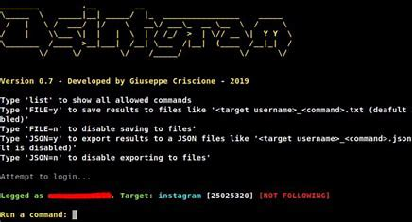
OSINTGRAM Installation
OSINTGRAM (Kali Linux):
git clone https://github.com/Datalux/Osintgram.git
cd Osintgram (navigates to the Osintgram directory)
python3 -m venv venv (creating a virtual environment for Osintgram)
source venv/bin/activate
pip install -r requirements.txt
Open credentials.ini file located in the config folder and put in credentials to your IG account. (MAKE A NEW IG ACCOUNT THAT CAN BE DISCARDED)
python3 main.py <target username> --command <command> (This runs the script)
Run this on your own Kali Linux machine don’t use Cyber Range computers

Slide 9
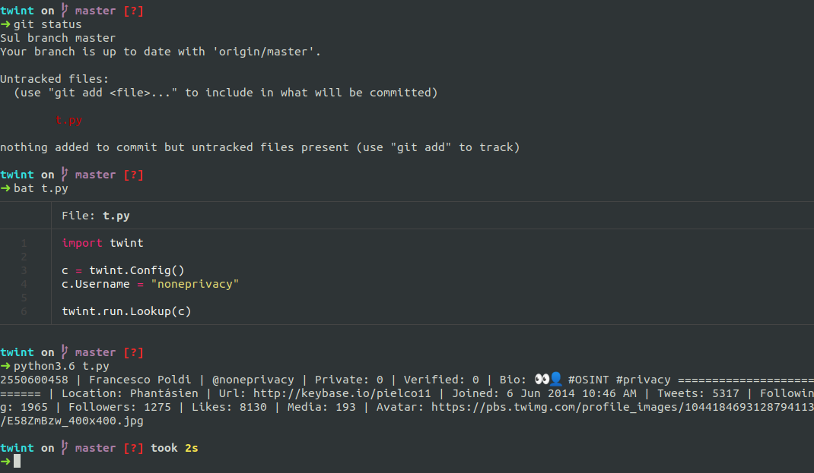
TWINT Installation
TWINT (Kali Linux/Google Cloud Console):
git clone –depth=1 https://github.com/twintproject/twint.git
cd twint (changing directory into twint)
pip3 install . -r requirements.txt
TO USE/HELP
twint -h (displays all the commands for twint to get more info)
twint -u <target username>
twint -u <target username> – limit <number of tweets>
twint -u <target username> -s “enter keyword/phrase”
twint -u <target username> –images (pulls up images)
twint -s <keyword> –near <area> –since <full date> –min-likes <like number>
twint -s <keyword> –since <full date> -g=“<coordinates x,y>,<radius>”
This also works using the google cloud console

Slide 10
PhoneInfoga Installation
PhoneInfoga(Kali Linux/Google Cloud Console):
# Add --help at the end of the command for a list of install options
bash <( curl -sSL https://raw.githubusercontent.com/sundowndev/phoneinfoga/master/support/scripts/install )
Type phoneinfoga (this will see if it’s downloaded)
phoneinfoga scan -n <phone number> (Don’t add dashes or symbols)
In a browser type <Local IP Host:5000> (This will bring you to the GUI. Easier to use)
The GUI also provides google dorks and other material

Slide 11
Objective
Try Google Dorking and utilize the GHDB
Use the quick search filter on the GHDB and look for “juicy information” (Open cameras, hidden login pages, PDFS of sensitive data, or admin pages
Try using tools like pimeyes, facecheck.id or the Kali Linux OSINT tools
Make a sock puppet account and use it for OSINTGRAM (OPTIONAL)
Have fun and if you want to use OSINT daily check out tracelabs.

